Slide 1






2022 AIAA Scitech Forum
3 – 7 January 2022
San Diego, CA & Online
An extensible Highly Parametric Open-Source Wingbox Generation Framework
Miguel Rodríguez-Segade, Jacobo Díaz, Santiago Hernández
Universidade da Coruña
miguel.alonso1@udc.es
Notes:
1

Slide 2
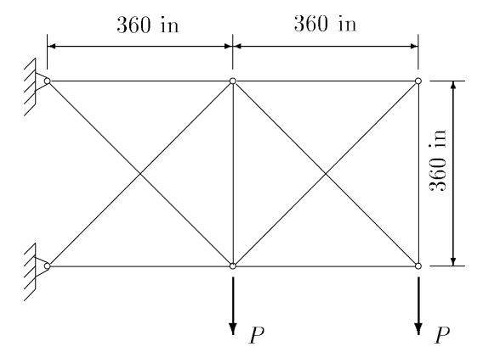
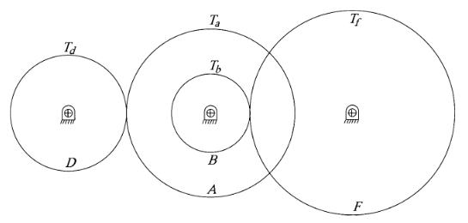
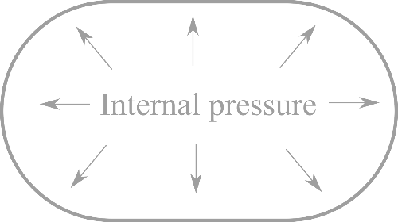
1. Introduction and objective
Most of the academic work in structural optimization is tested using well-known benchmark problems, such as simple trusses, cantilevers, pressure vessels, or gear trains.
Examples of highly cited publications in structural optimization:
Grey Wolf Optimizer - Tension/Compression spring, Pressure vessel, Welded Beam
Particle Swarm Optimization – 2-bar plane truss, 10-bar plane truss, 25-bar plane truss and a torque arm.
Cucko Search Algorithm – Pin-Jointed Plane Frame, Piston Lever, Cantilever Beam, Three bar truss, gear train -> FEM model, but not available.
Notes:
2

Slide 3
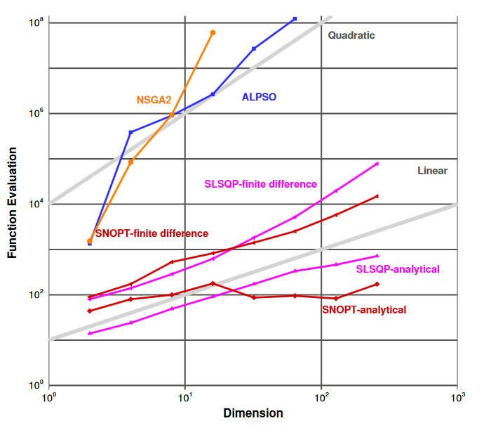
1. Introduction and objective
With large number of design variables or computationally expensive models, the successful applicability of this methods is not straightforward
[Lyu et al. ICCFD8-2014-0203]
Notes:
3

Slide 4
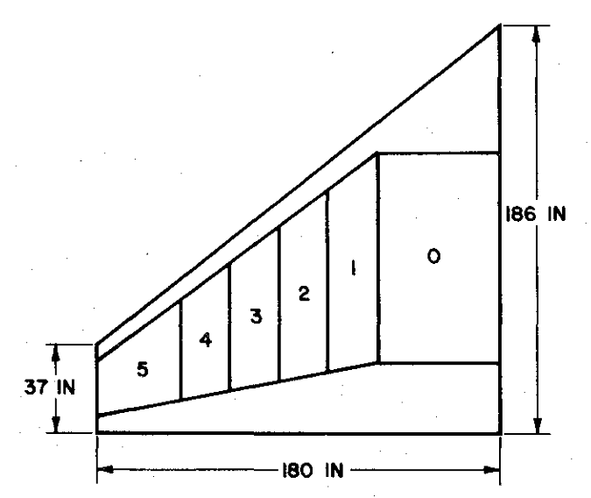
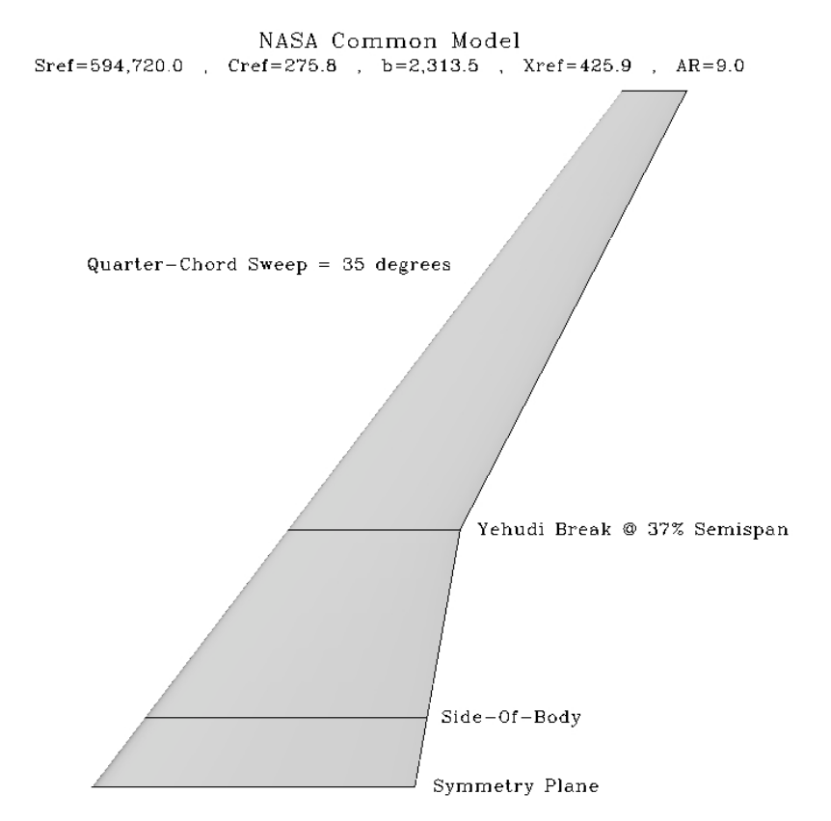
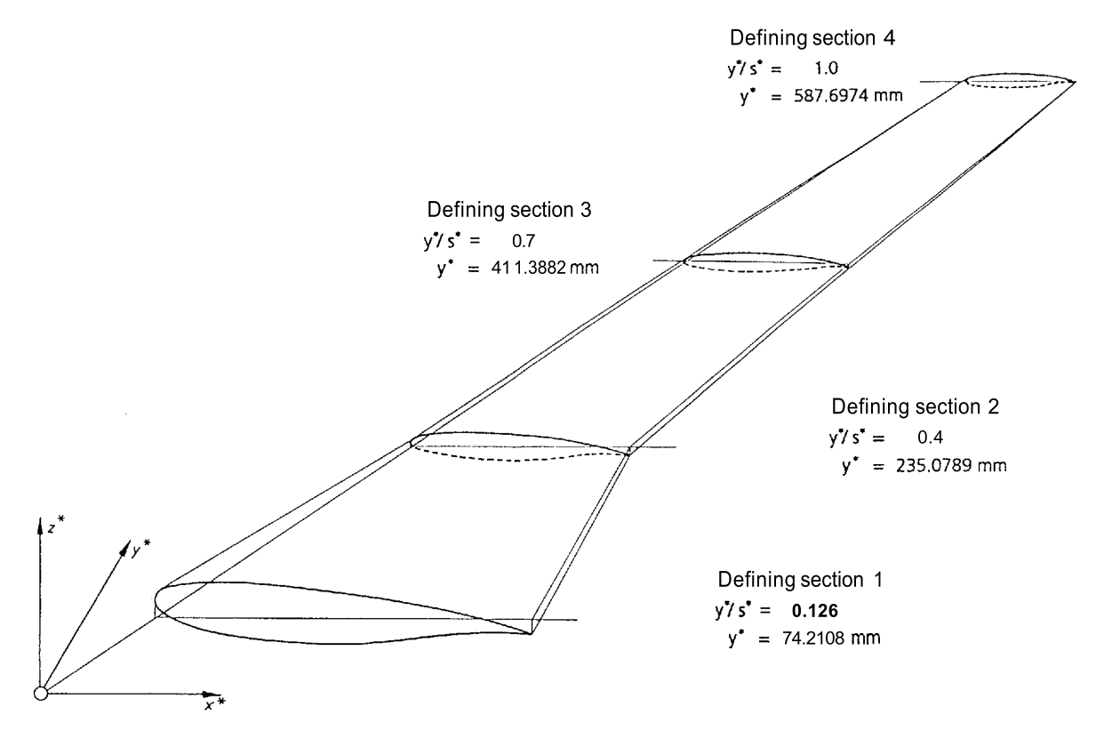
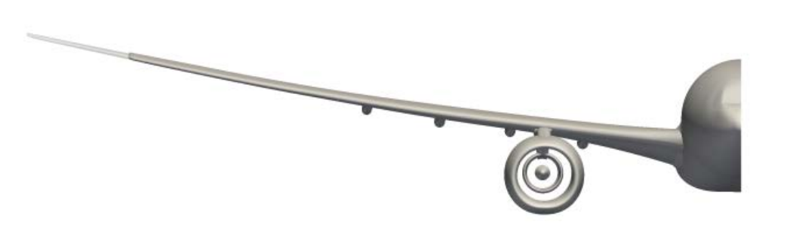
1. Introduction and objective
One of the most researched topics in aircraft design is the aero-structural optimization of the wing. Multiple wing models have been proposed to serve as a reference for researchers
Haftka Wing MDO
NASA CRM
[Vassberg 2008]
[Haftka 1977]
DLR-F4
Airbus XRF-1
[Redeker 1994]
[Pattinson 2015]
Notes:
4

Slide 5
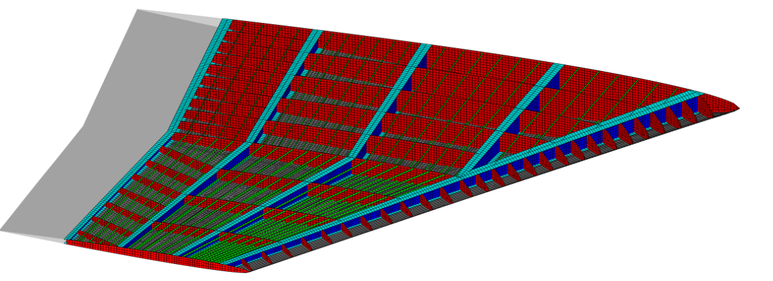
1. Introduction and objective
Recently, a lot of effort has been done to obtain parametric models suitable for aerolastic studies
[Senseimer et al. 2006]
[Skillen et al. 2008]
[Hürliman et al. 2011]
[Chaput et al. 2012]
[Tang et al. 2013]
[Hwang et al. 2014]
[Chaput 2015]
[Love et al. 2017]
[Gandhi et al. 2021]
[Qian 2017]
Notes:
5

Slide 6
1. Introduction and objective
Main issues.
Not parametric enough
How to solve-them
Systematic definition
Notes:
6

Slide 7
1. Introduction and objective
Main issues.
Not parametric enough
Non-extensible
How to solve-them
Systematic definition
Object-oriented approach
Notes:
7

Slide 8
1. Introduction and objective
Main issues.
Not parametric enough
Non-extensible
Locked to a comercial software
How to solve-them
Systematic definition
Object-oriented approach
Standard formats: HDF5,BDF, STEP
Notes:
8

Slide 9
1. Introduction and objective
Main issues.
Not parametric enough
Non-extensible
Locked to a comercial software
Licensing times
How to solve-them
Systematic definition
Object-oriented approach
Standard formats: HDF5,BDF, STEP
Open-source
Notes:
9

Slide 10
1. Introduction and objective
Main issues.
Not parametric enough
Non-extensible
Locked to a comercial software
Licensing times
Launching in a HPC Cluster
How to solve-them
Systematic definition
Object-oriented approach
Standard formats: HDF5,BDF, STEP
Open-source
Parallelizable and batch
Notes:
10

Slide 11
1. Introduction and objective
Main issues.
Not parametric enough
Non-extensible
Locked to a comercial software
Licensing times
Launching in a HPC Cluster
Lack of robustness
How to solve-them
Systematic definition
Object-oriented approach
Standard formats: HDF5,BDF, STEP
Open-source
Parallelizable and batch
Unit testing
Notes:
11

Slide 12
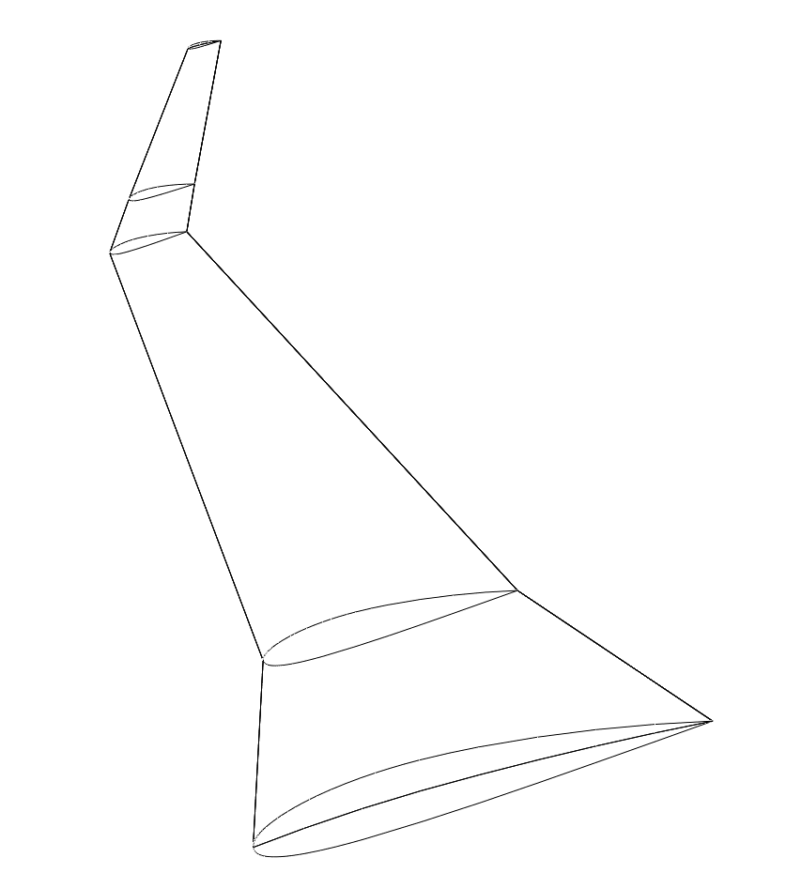
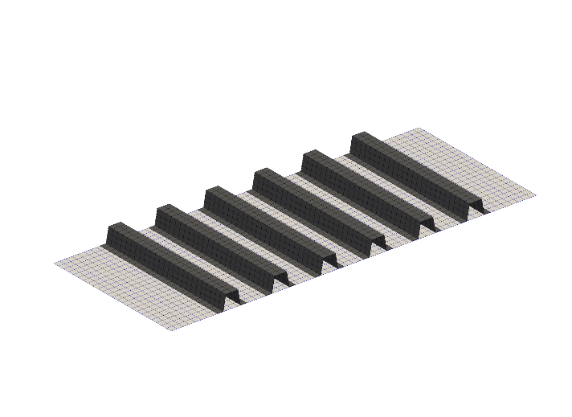
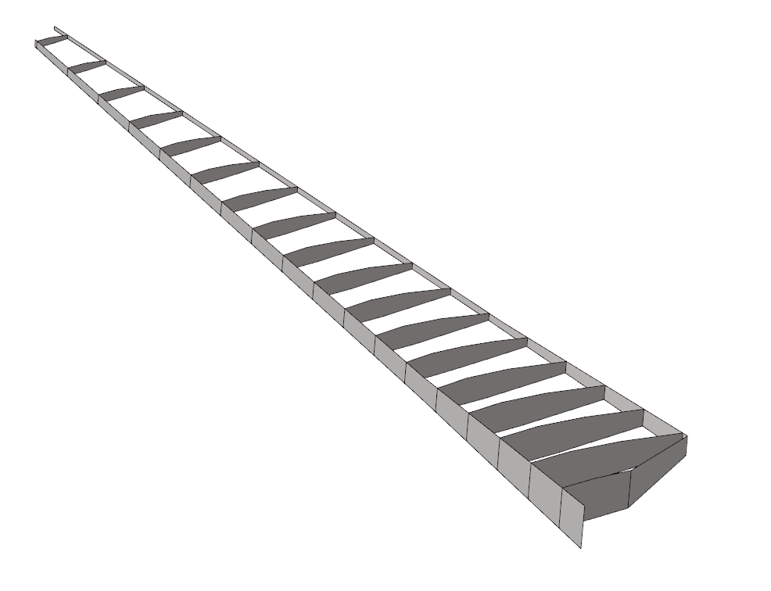
2. Wingbox Model Definition
Systematic way of completely define a complex wing configuration
Outer Mold Line
Structural Configuration
Internal Dimensions
Notes:
12

Slide 13
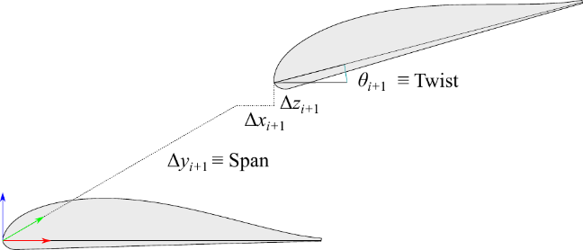
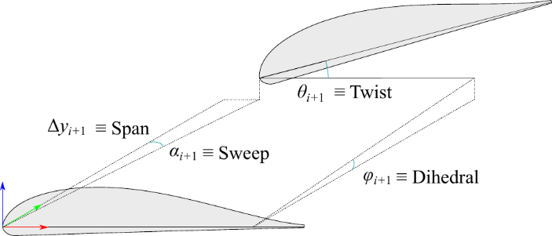
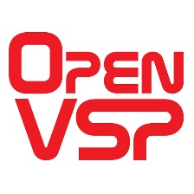
2. Wingbox Model Definition
Multiple ways to define it
Outer Mold Line
3 Translations
1 Angle
3 Angles
1 Translation
There already exists Open-Source software that allows for a systematic definition of the Outer Mold Line
Notes:
13

Slide 14
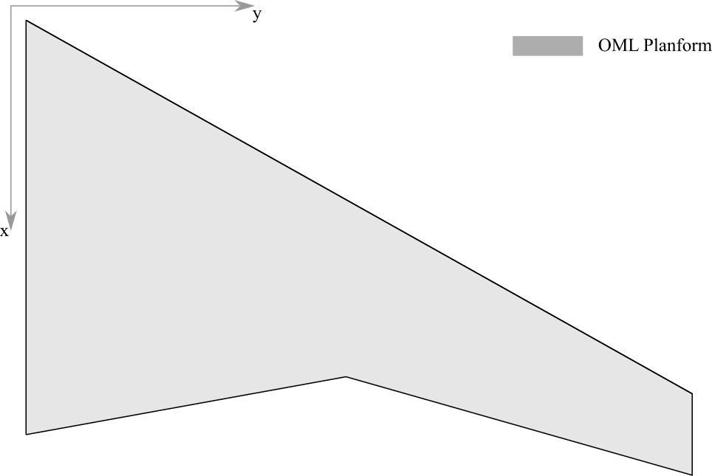
2. Wingbox Model Definition
Structural Configuration
Notes:
14

Slide 15
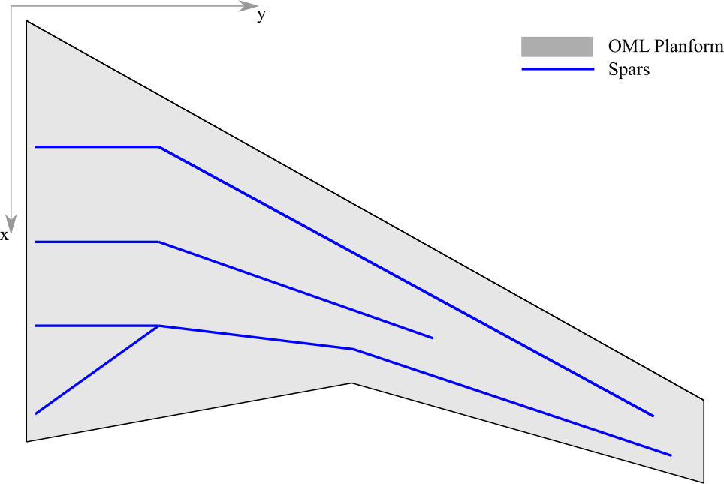
2. Wingbox Model Definition
Structural Configuration
Notes:
15

Slide 16
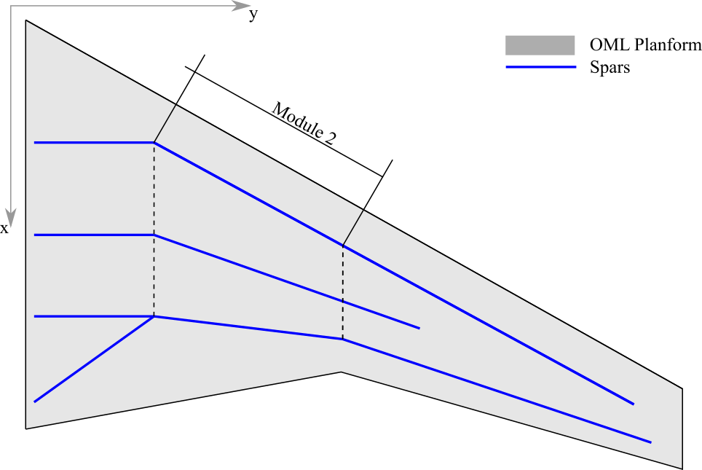
2. Wingbox Model Definition
Structural Configuration
Notes:
16

Slide 17
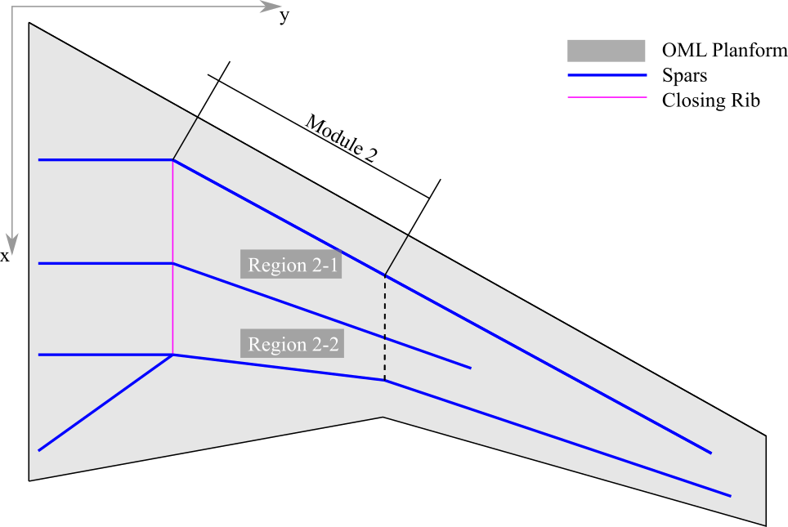
2. Wingbox Model Definition
Structural Configuration
Notes:
17

Slide 18
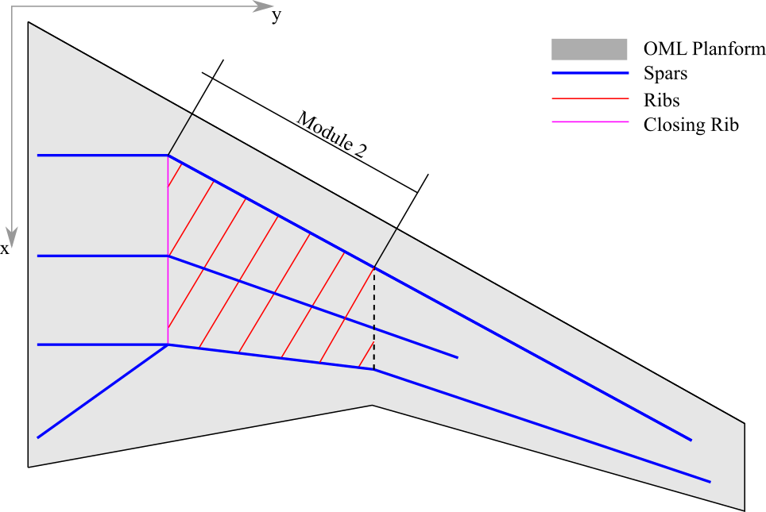
2. Wingbox Model Definition
Structural Configuration
Notes:
18

Slide 19
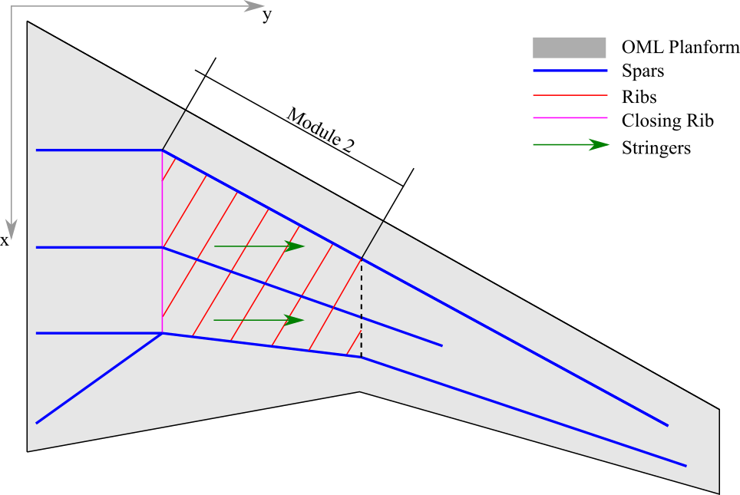
2. Wingbox Model Definition
Structural Configuration
Notes:
19

Slide 20
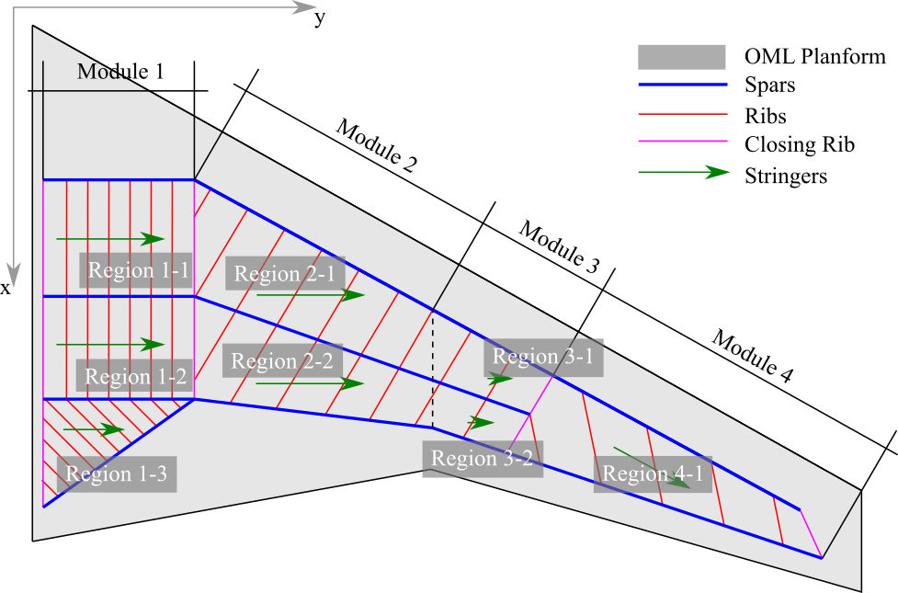
2. Wingbox Model Definition
Structural Configuration
Notes:
20

Slide 21
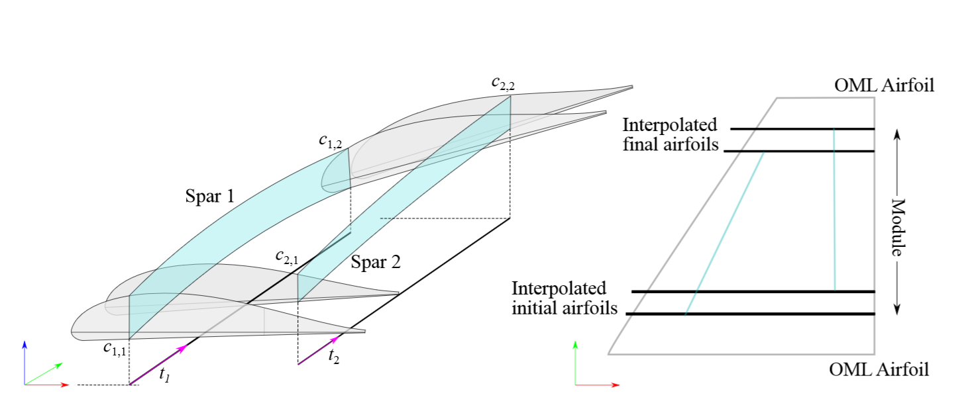
2. Wingbox Model Definition
Spar Definition
The spars are defined as planar surfaces, parallel to the z-vector.
Interpolation of airfoils is required to define the initial and final positions of the spars.
A parametric coordinate t is used to define the position of the ribs.
Notes:
21

Slide 22
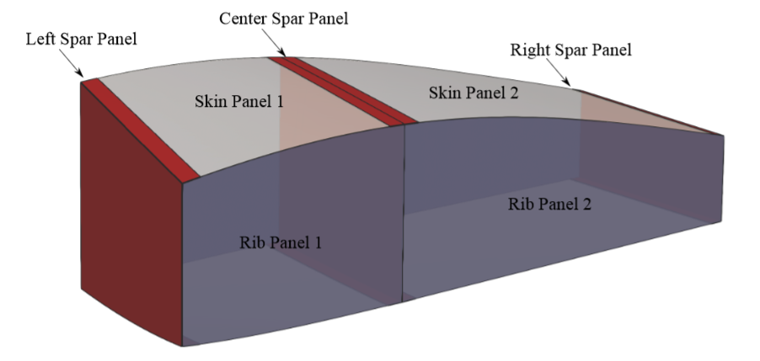
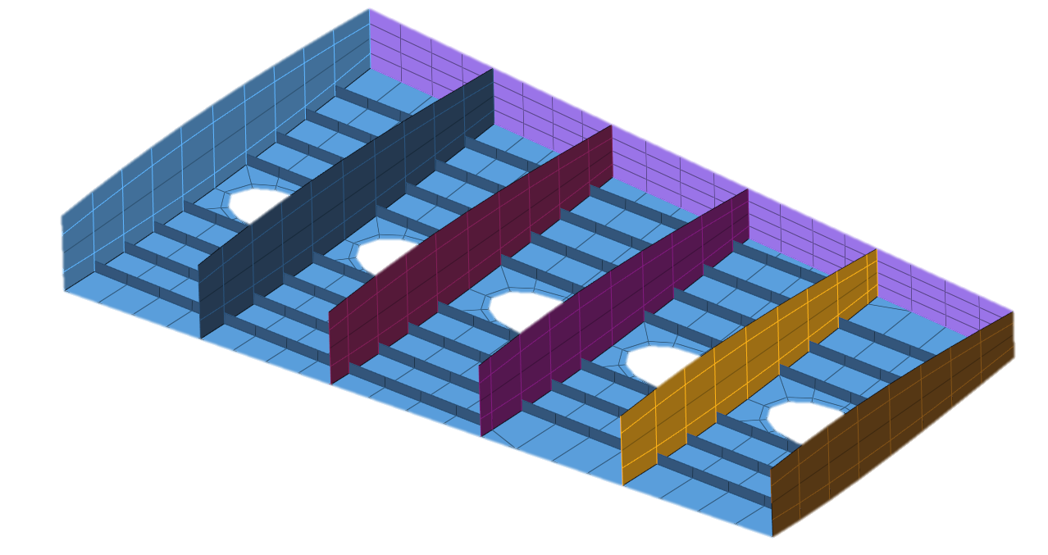
2. Wingbox Model Definition
Panels
All panels (rib, spar and skin) can have their stringer orientation, and a hole can be defined inside the surface
Different sections can be applied to spars and ribs, such as I, C or Z profiles
Notes:
22

Slide 23
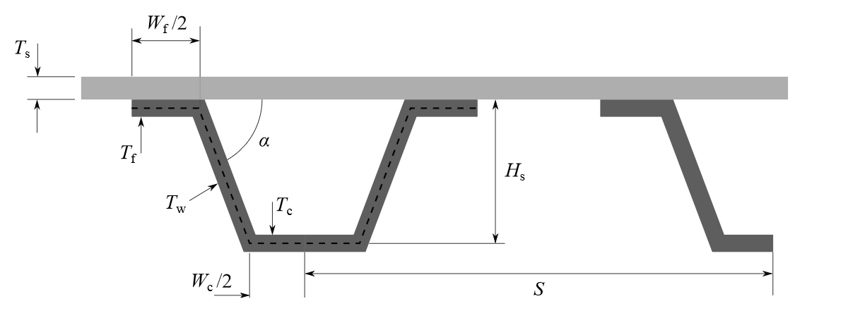
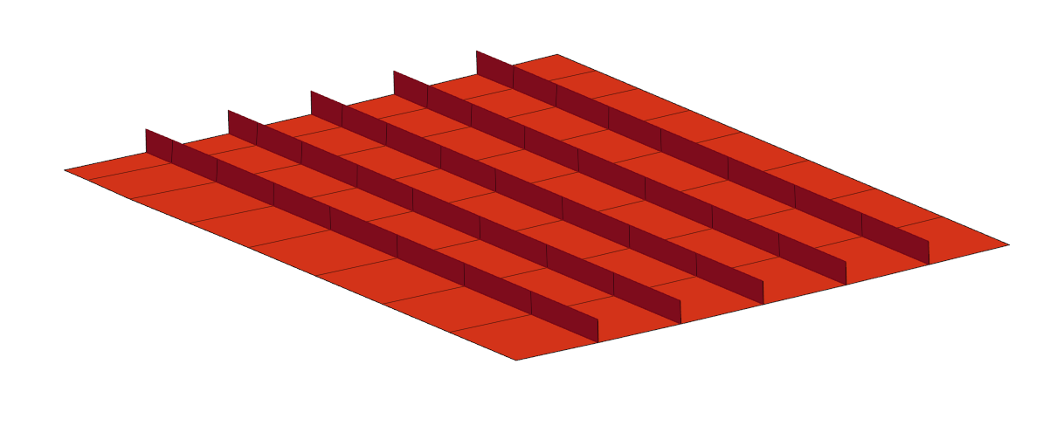
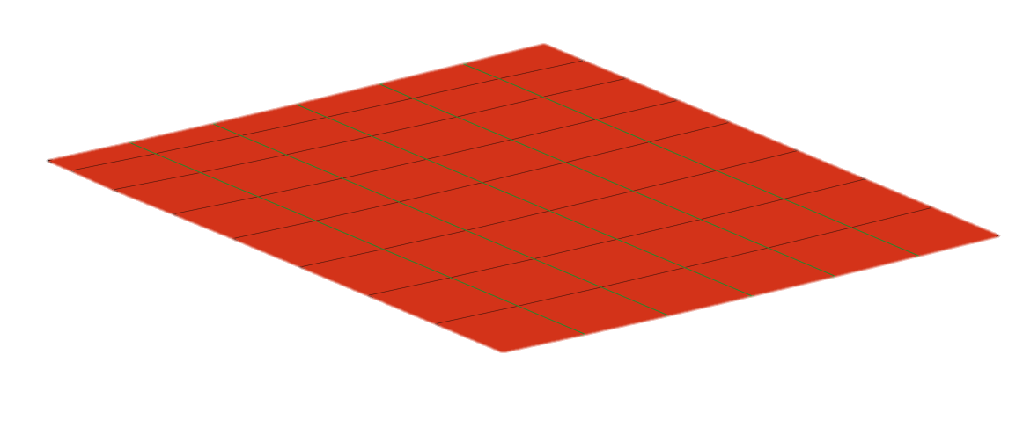
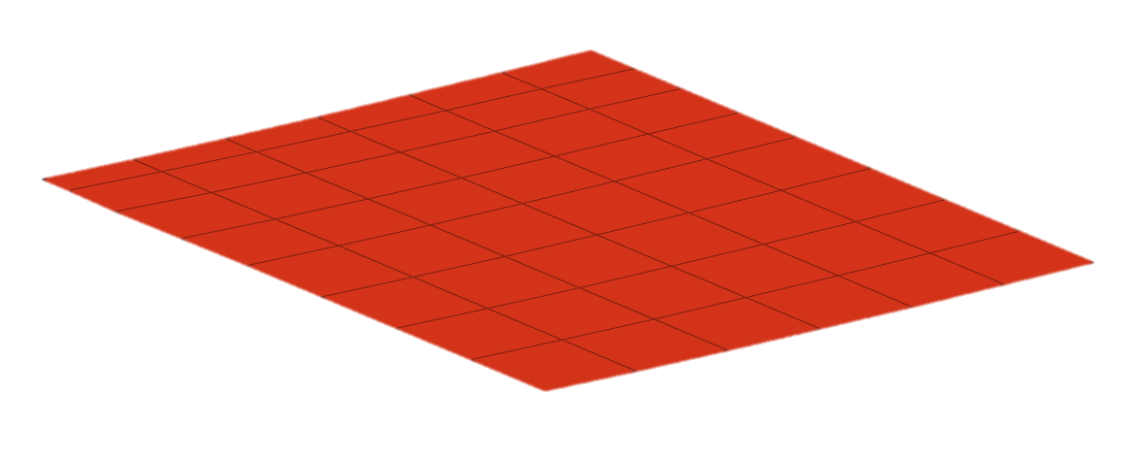
2. Wingbox Model Definition
Internal Dimensions
Stringers have different dimensions depending on the configuration: I, C, Z, Hat, Inverted Hat or corrugated skin.
All variables are continuous, to allow for gradient based optimization.
The stringers can be represented using:
Shell elements
Beam elements
Equivalent properties
Shells
Beams
Smeared stiffness
Notes:
23

Slide 24
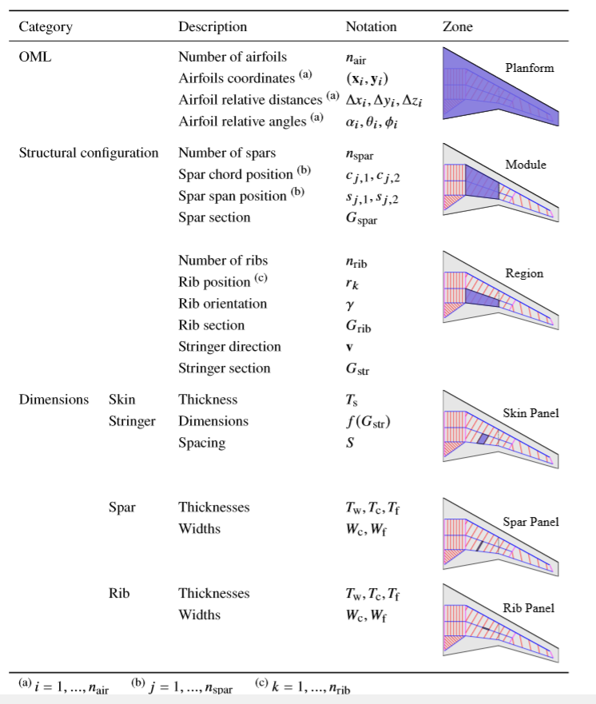
2. Wingbox Model Definition
Internal Dimensions
Notes:
24

Slide 25
2. Wingbox Model Definition
Internal Dimensions
Notes:
25

Slide 26
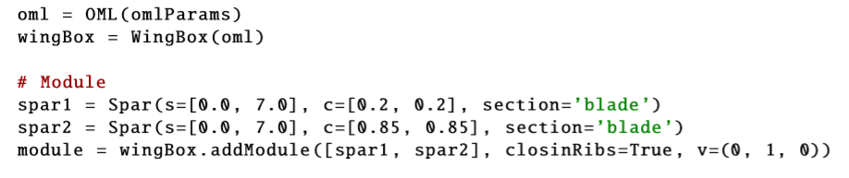
3. Code Architecture
Extendable
Embeddable
Standard
Python Library
Object oriented approach that abstracts the methodology
Notes:
26

Slide 27
3. Code Architecture
Extendable
Embeddable
Standard
Python Library
Object oriented approach that abstracts the methodology
Airfoil Sections
Angles and Translations
Notes:
27

Slide 28
3. Code Architecture
Extendable
Embeddable
Standard
Python Library
Object oriented approach that abstracts the methodology
Start and End
Chordwise positions
Notes:
28

Slide 29
3. Code Architecture
Extendable
Embeddable
Standard
Python Library
Object oriented approach that abstracts the methodology
Stringer Orientation
Notes:
29

Slide 30
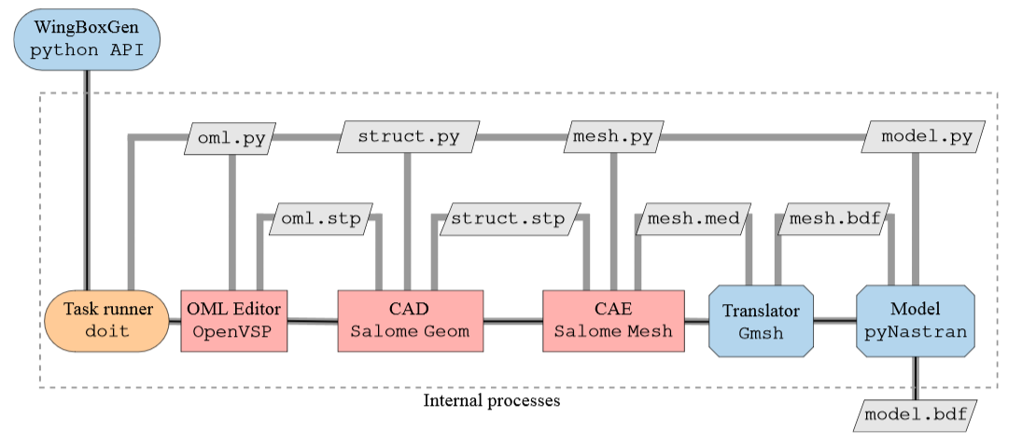
3. Code Architecture
Internal Processes Pipeline
Notes:
30

Slide 31
3. Code Architecture
All steps are controlled through a python interface
Notes:
31

Slide 32
3. Code Architecture
Standard input and output formats
Notes:
32

Slide 33
3. Code Architecture
Open source software, no license requiered
Notes:
33

Slide 34
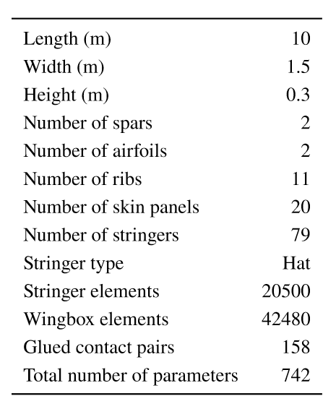
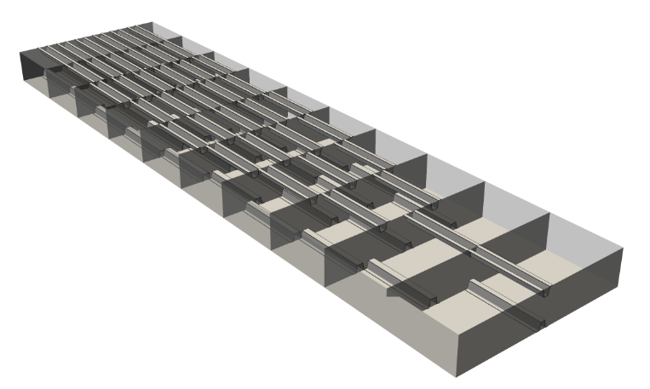
4. Application Examples
Rectangular wingbox with shell defined stringers
Notes:
34

Slide 35
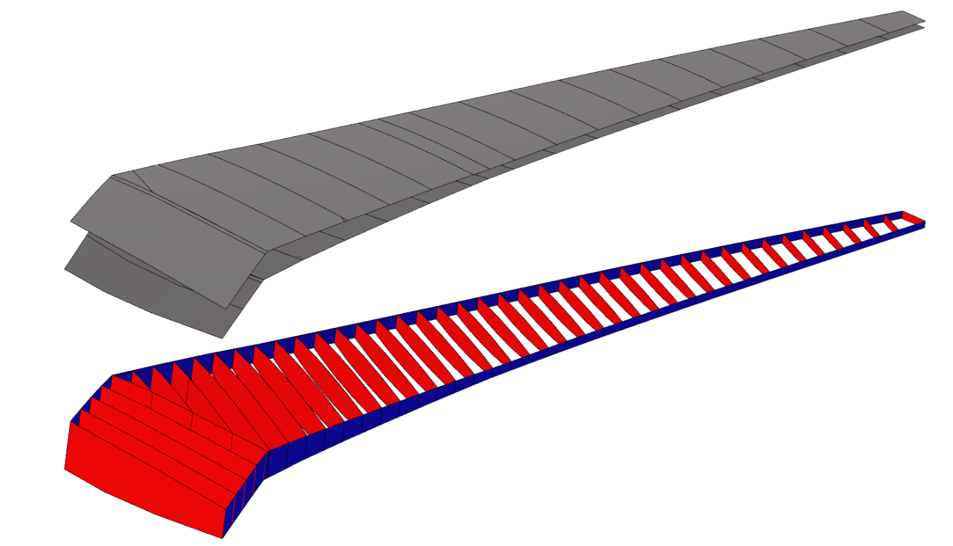
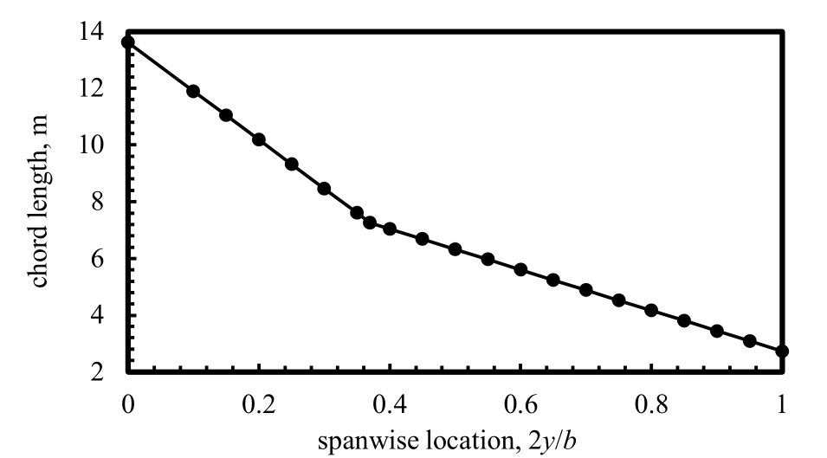
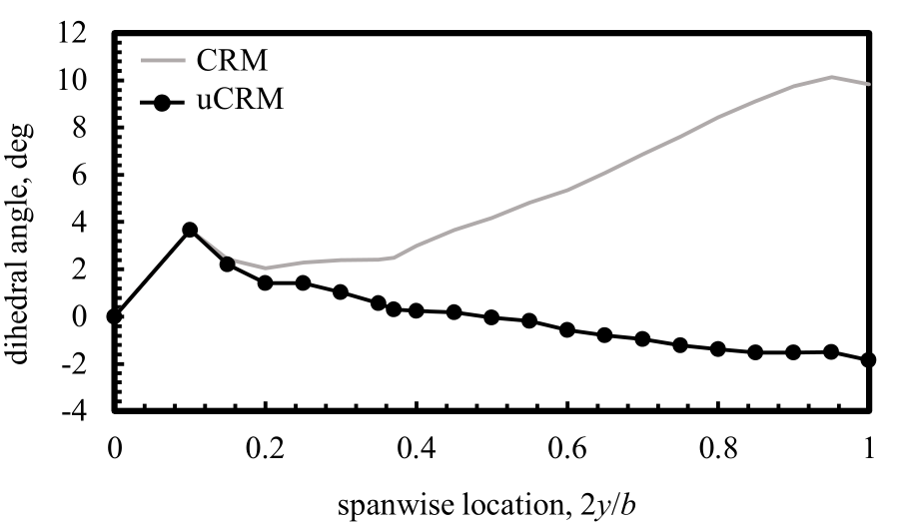
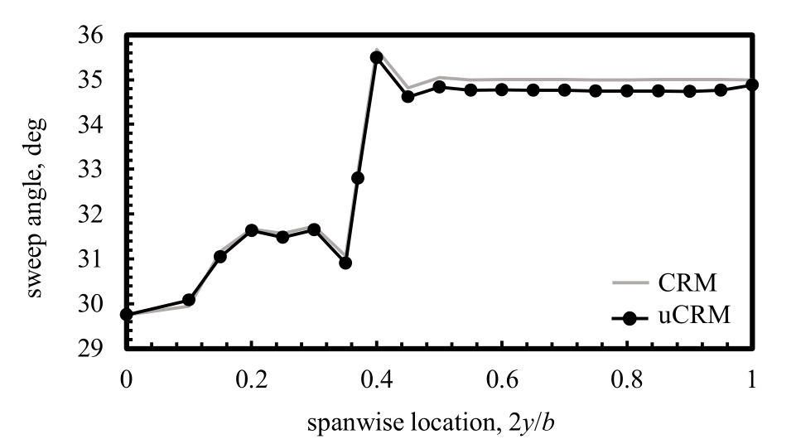
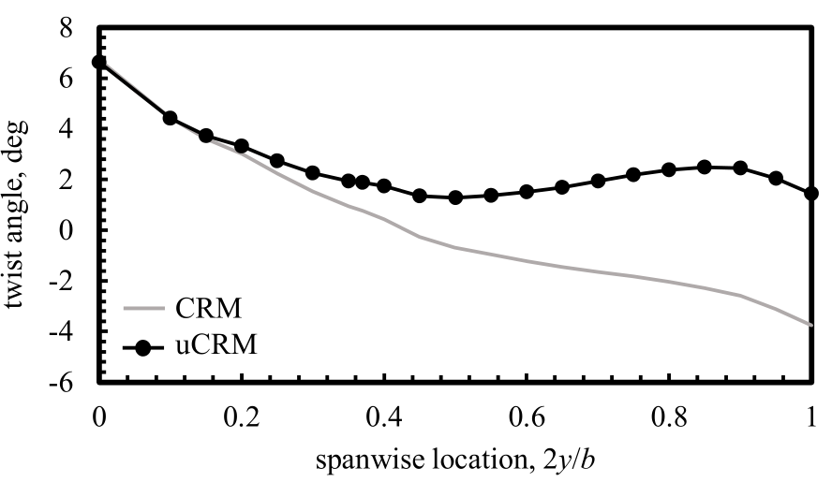
4. Application Examples
Common Research Model
Skin panels
[Taylor et al. Scitech 2021]
Ribs and spars
The obtained geometry and mesh has good accuracy compared with the original model
Modifications in any structural parameters yields a valid design
Notes:
35

Slide 36
5. Conclusions
The research community has a lack of parametric, industry-like models to test their optimization formulations.
A highly parametric framework for wingbox design has been developed to perform parametric analyses and optimizations.
Aerodynamic and structural parameters are considered to obtain realistic and detailed configurations
The software is released under an open-source license to facilitate its dissemination, with the aim of providing real-world models for use by researchers.
Notes:
36

Slide 37
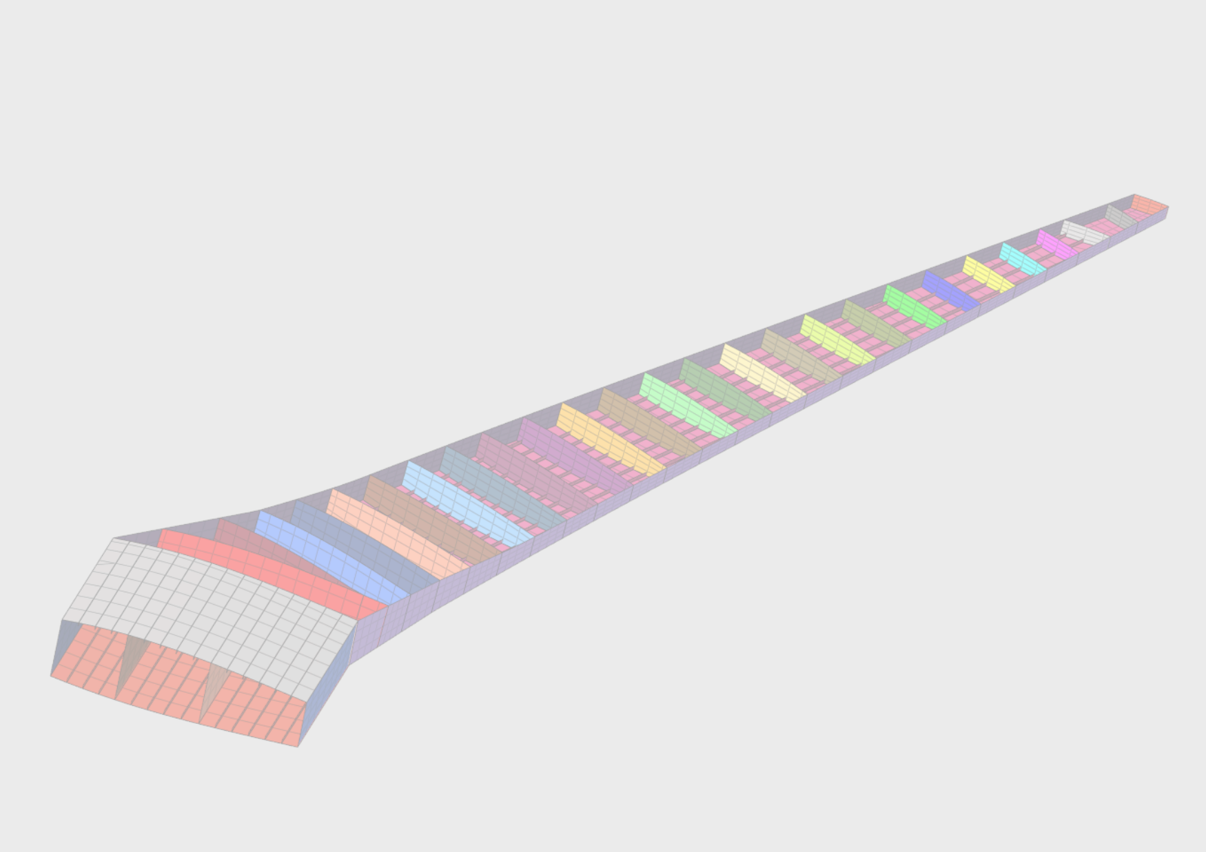
Thank you for your attention
This research was sponsored by:
Notes:
37

